Slide 1
Cyclistic Data Analysis

Slide 2
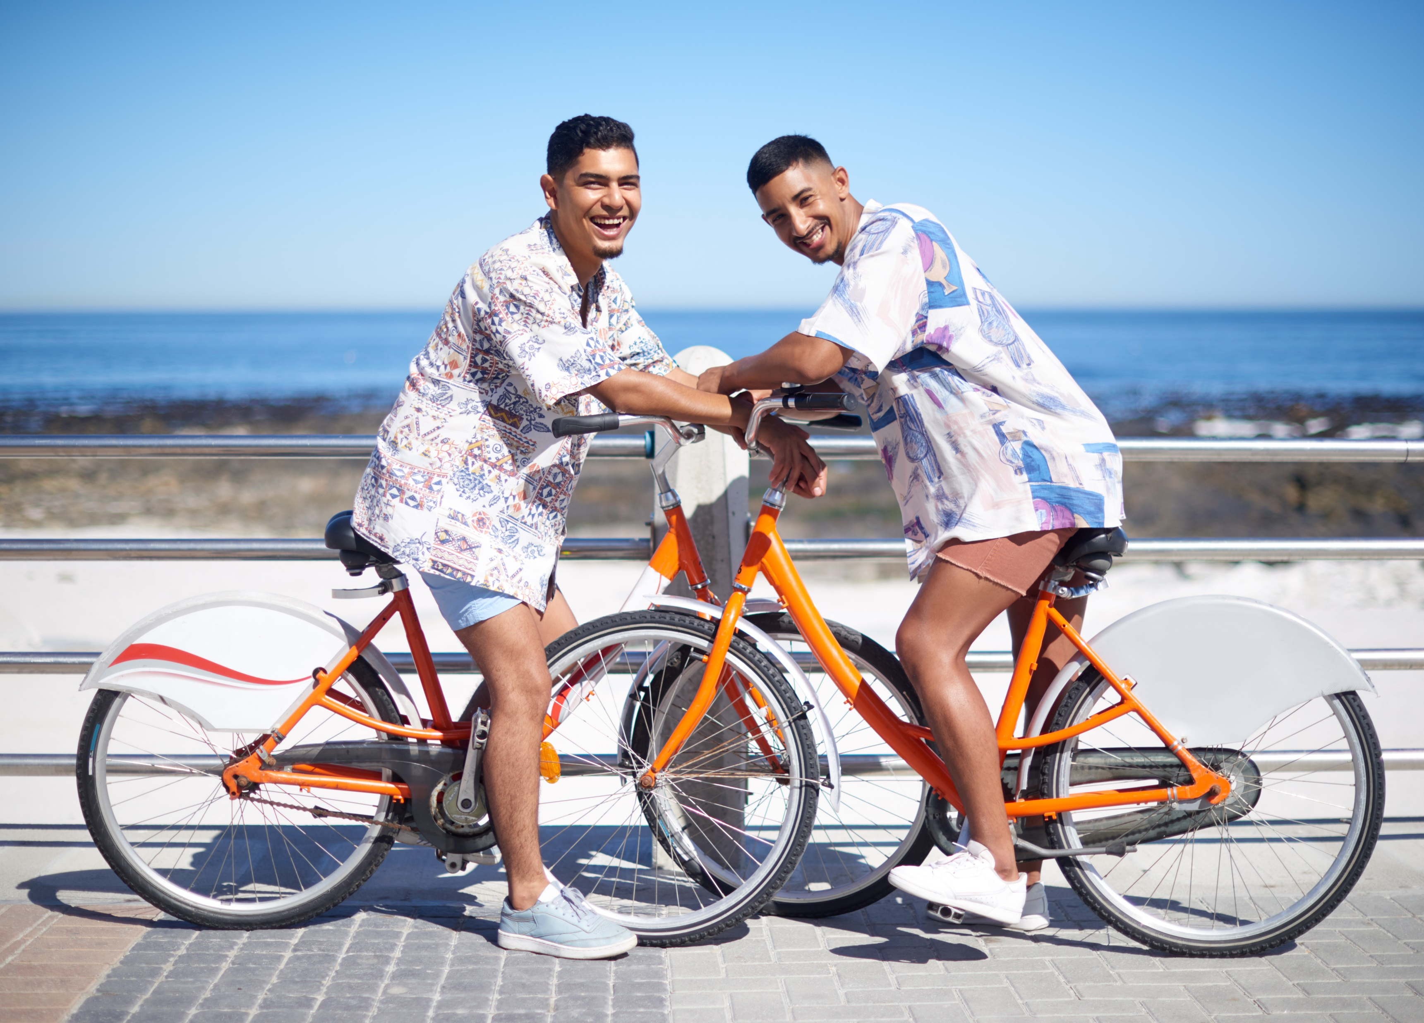
Business Question
How can Cyclistic’s marketing strategy be improved to have casual riders buy more memberships?

Slide 3
Executive Summary
Cyclistic’s casual riders tend to be more recreational riders or those who wish to avoid traffic
Information:
Around 43% of ride from April 2020 to June 2021 were from casual riders
2020 saw an overall dip in the number of bike shares in comparison to 2021, likely due to COVID-19
Casual riders use the bike shares more on weekends and in Spring/Summer
Many casual riders use the service in busy Chicago districts for shorter time frames
In order to gain more members, Cyclistic should focus marketing effort on several key hotspot areas and create campaigns and promotions as warmer months approach

Slide 4
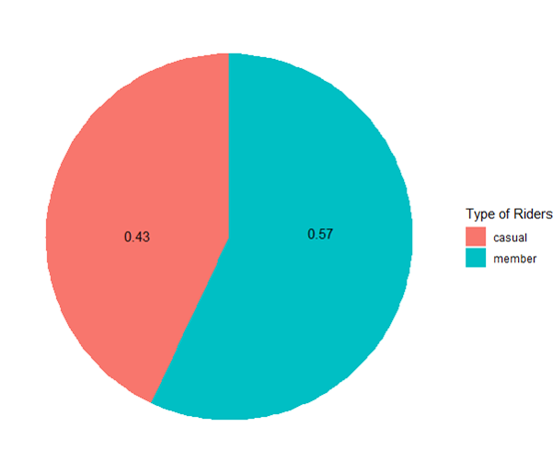
Around 43% of ride from April 2020 to June 2021 were from casual riders

Slide 5
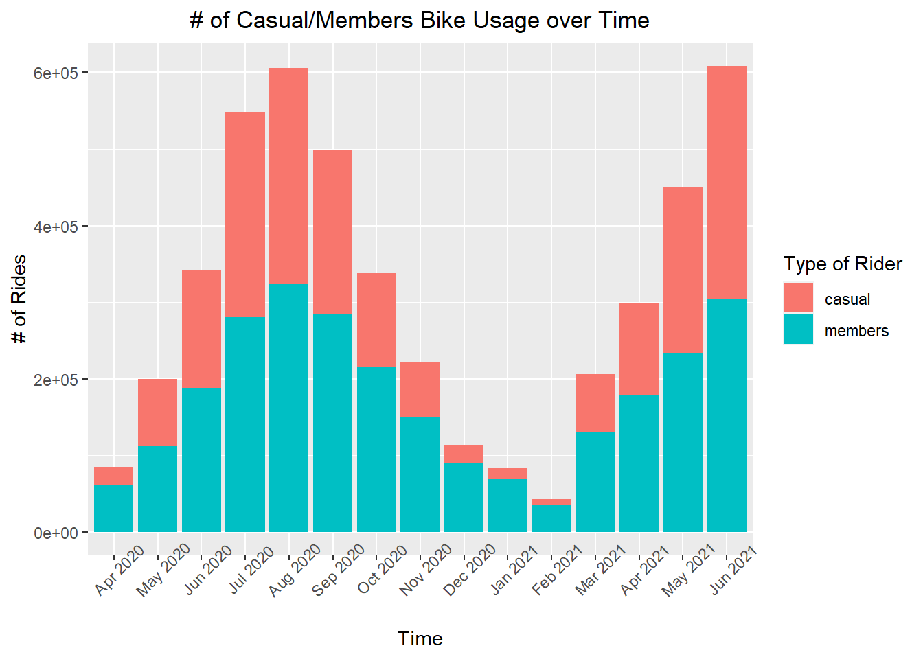
2020 saw an overall dip in the number of bike shares in comparison to 2021

Slide 6
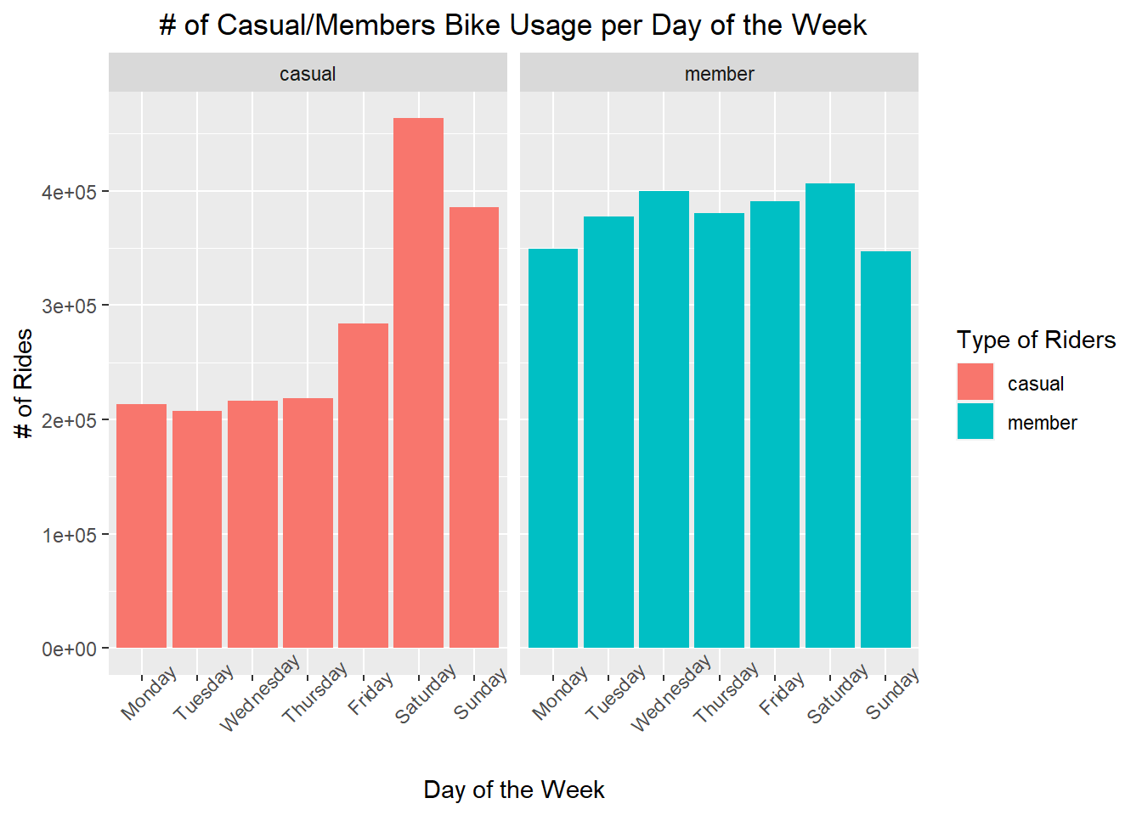
Casual riders use the bike shares more on weekends and in Spring/Summer

Slide 7
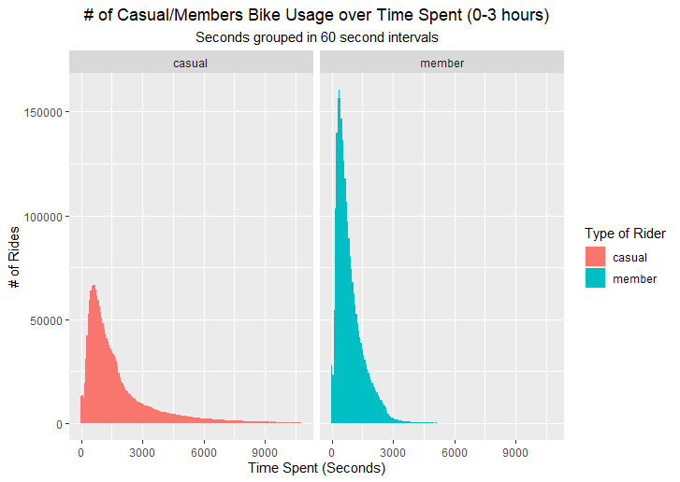
Many casual riders use the service in busy Chicago districts for shorter time frames

Slide 8
Locations
Bolded station names are considered hotspots for either casual riders or members For a complete list, please refer the Excel file station_frequency.xlsx
 | Start Station | End Station
Casual Riders | 1. Streeter Dr & Grand Ave 2. Lake Shore Dr & Monroe St 3. Millennium Park 4. Michigan Ave & Oak St 5. Lake Shore Dr & North Blvd 6. Theater on the Lake 7. Indiana Ave & Roosevelt Rd 8. Shedd Aquarium 9. Michigan Ave & Lake St 10. Clark St & Elm St | 1. Streeter Dr & Grand Ave 2. Lake Shore Dr & Monroe St 3. Millennium Park 4. Lake Shore Dr & North Blvd 5. Theater on the Lake 6. Michigan Ave & Oak St 7. Indiana Ave & Roosevelt Rd 8. Michigan Ave & Lake St 9. Clark St & Elm St 10. Wells St & Concord Ln
Members | 1. Clark St & Elm St 2. Wells St & Concord Ln 3. Dearborn St & Erie St 4. Broadway & Barry Ave 5. Kingsbury St & Kinzie St 6. St. Clair St & Erie St 7. Wells St & Elm St 8. Theater on the Lake 9. Lake Shore Dr & North Blvd 10. Wells St & Huron St | 1. Clark St & Elm St 2. Wells St & Concord Ln 3. St. Clair St & Erie St 4. Dearborn St & Erie St 5. Broadway & Barry Ave 6. Kingsbury St & Kinzie St 7. Lake Shore Dr & North Blvd 8. Wells St & Elm St 9. Theater on the Lake 10. Wells St & Huron St

Slide 9
Recommendation Actions
Advertise on locations where casual riders have longer and/or more frequent bike shares
Includes the previous list above as well as the Chicago Loop area
Advertising based on avoiding traffic and health
Increase advertising around 4-6 pm
Increase advertising during the weekend
Increase advertising either right before or at the start of Spring
Create campaigns and promotions on social media

